Slide 1
Sectional Views

Slide 2
Introduction
Sections are used to show interior details clearly.
A cutting-plane line shows where object was cut to obtain the section view.
Cross hatching in the section view shows the solid surface of the object which were cut through to produce the section.
Section views may replace standard views.
Conventional practices, such as not showing hatching on ribs and webs, help make sections easier to interpret correctly.

Slide 3
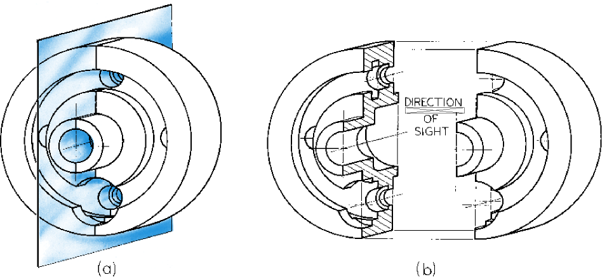
Full Section
Imagine the object cut through by the cutting plane. Think of the two halves pulled apart and a view looking on to the cut half.

Slide 4
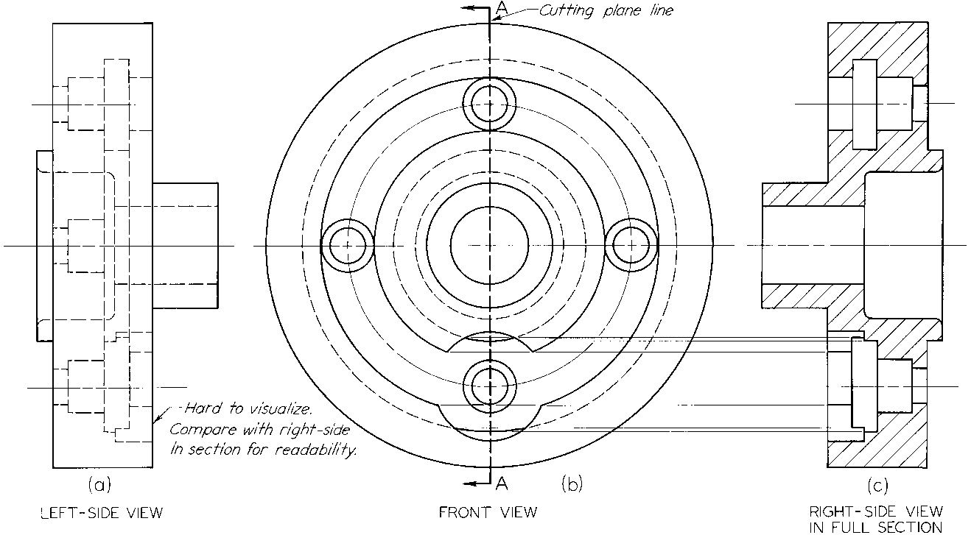
Full Sections
Full sections show the object cut in half
Cutting plane line can be left out because it is understood to be through center
Usually replaces a standard view

Slide 5
The Cutting Plane Line
The cutting plane line is a thick dark line which uses one of the special patterns shown above.
The cutting plane line can be left out when it is obvious where it must lie from the appearance of the section itself.

Slide 6
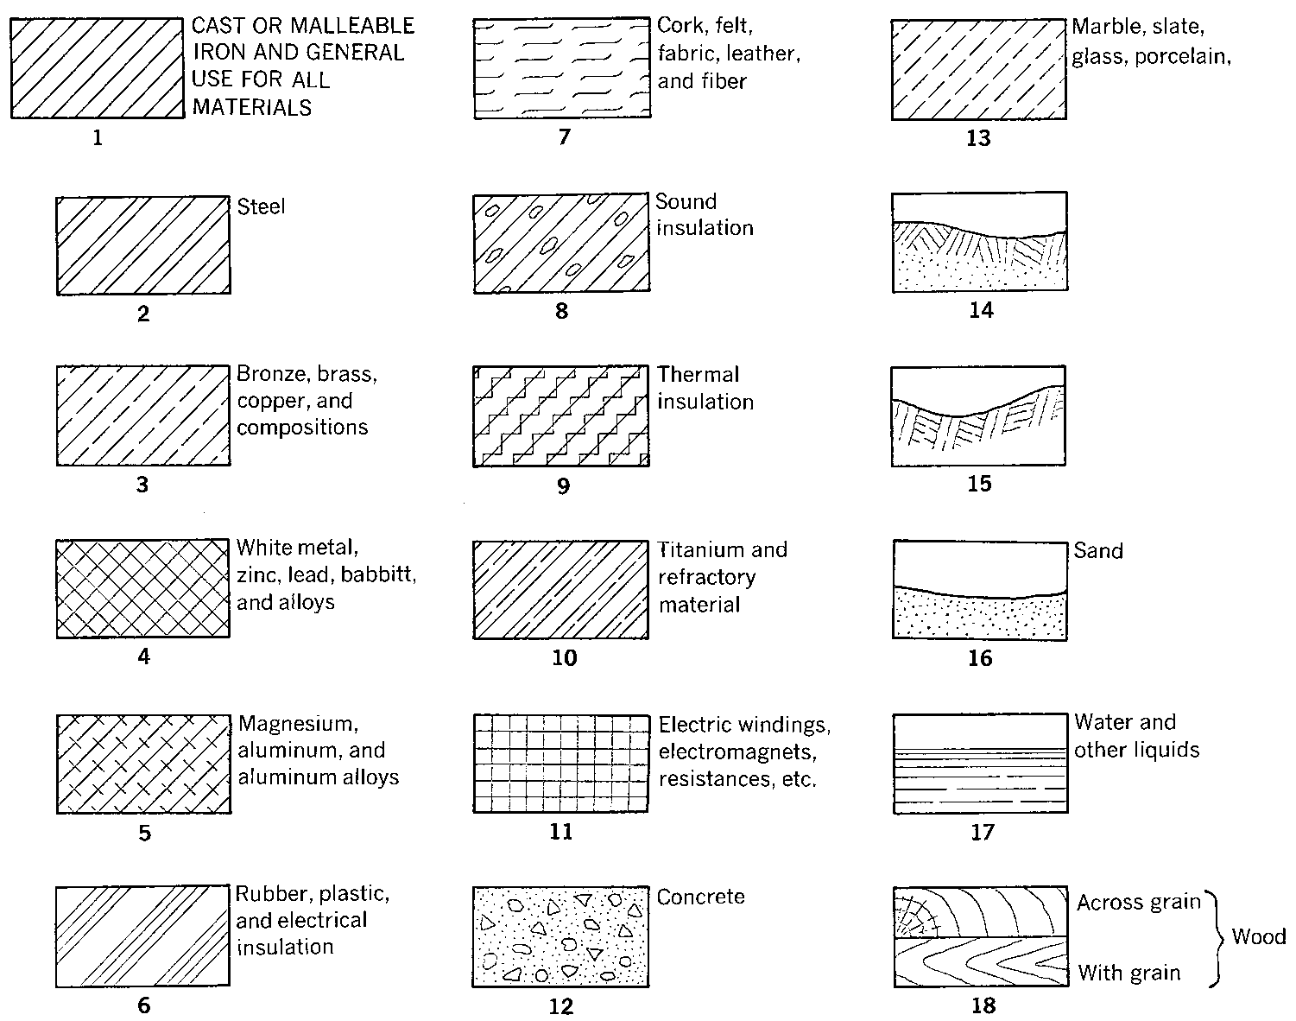
Hatch Patterns

Slide 7
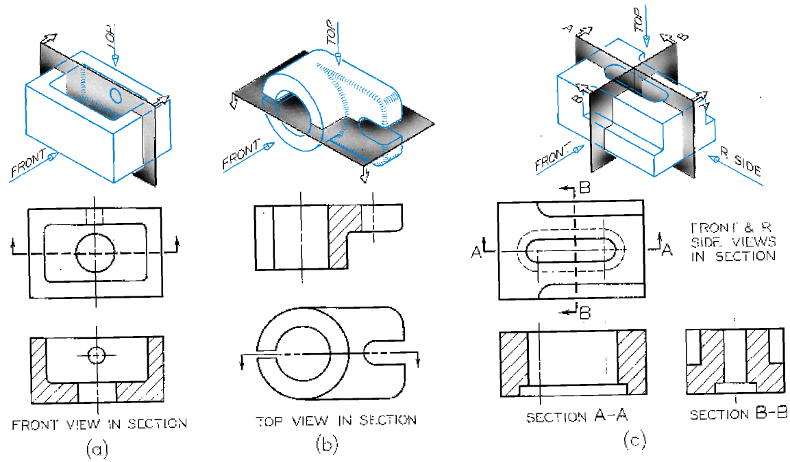
Cutting Planes & Sections

Slide 8
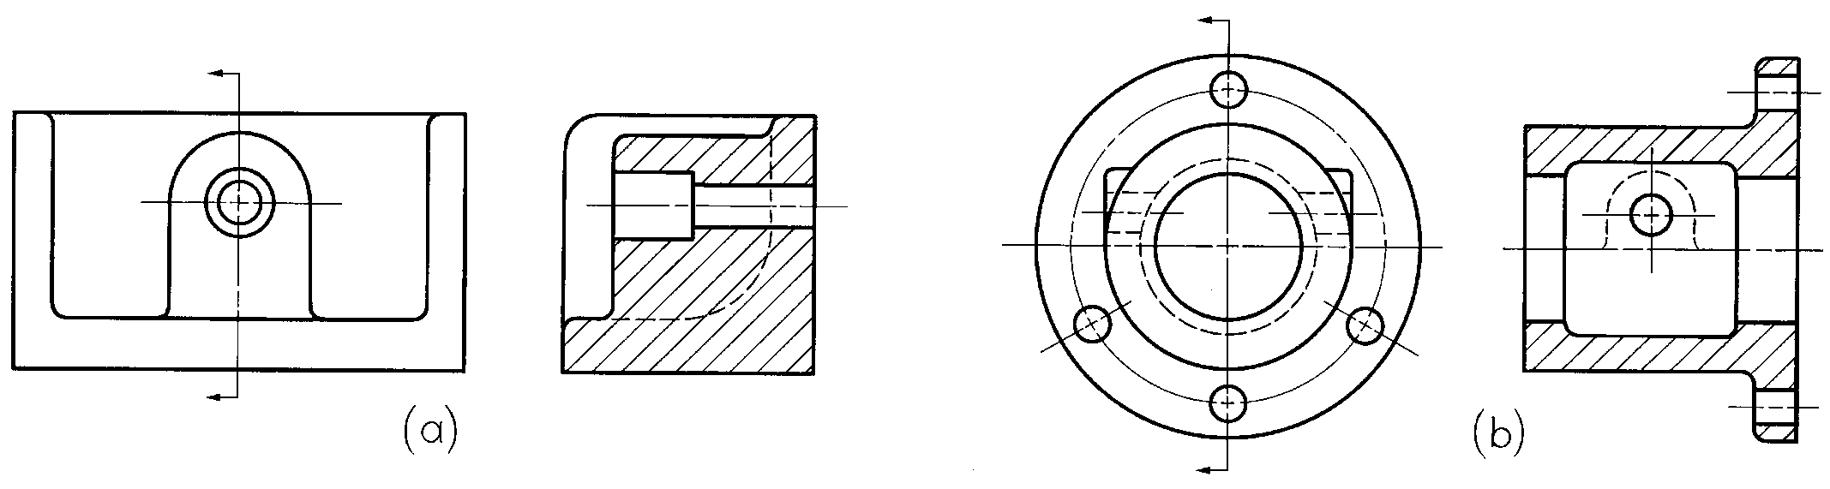
Lines in the Section View
show lines that may have been previously hidden, but are now visible behind cutting plane
usually don’t show hidden lines in section-- section views are to make interior details clear without hidden lines
show hidden lines only when the object would be misinterpreted if they were not shown.

Slide 9
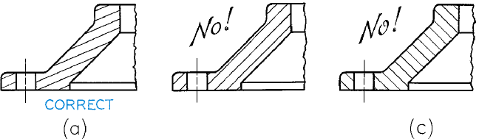
Some Rules for Hatching
Adjacent areas divided by a visible line in a section view never both contain hatching.
Hatching is never bounded by a hidden line.
Hatching should not run parallel or perpendicular to a major feature.

Slide 10
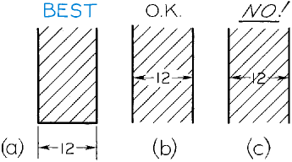
Dimension Values
& Hatching
Sectional views are often used to show interior features clearly for dimensioning. If dimension values or extension lines cross hatched areas, you should break the hatching behind the dimension. The best practice is to place dimensions outside the object outline.

Slide 11
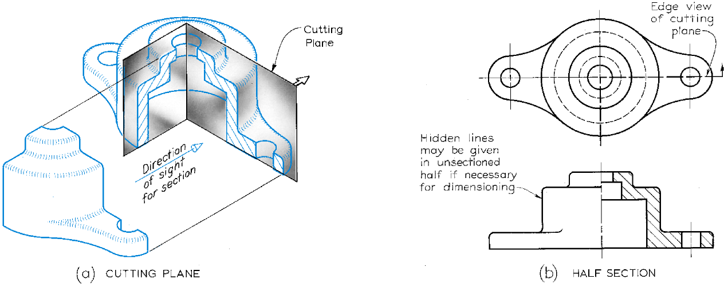
Half-Sections

Slide 12
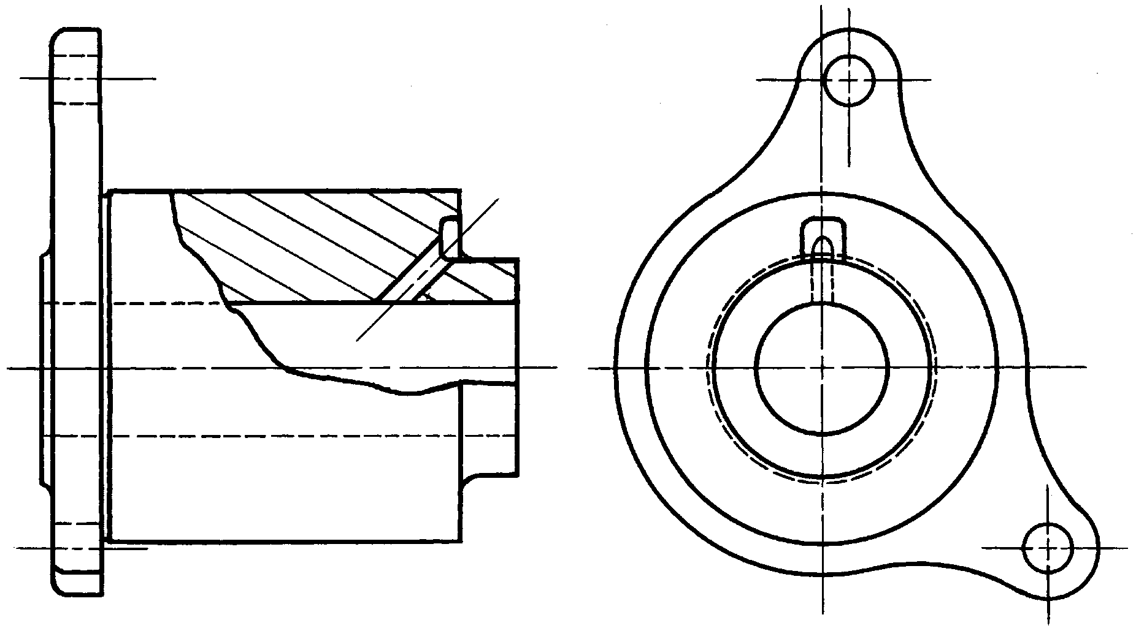
Broken-out Sections

Slide 13
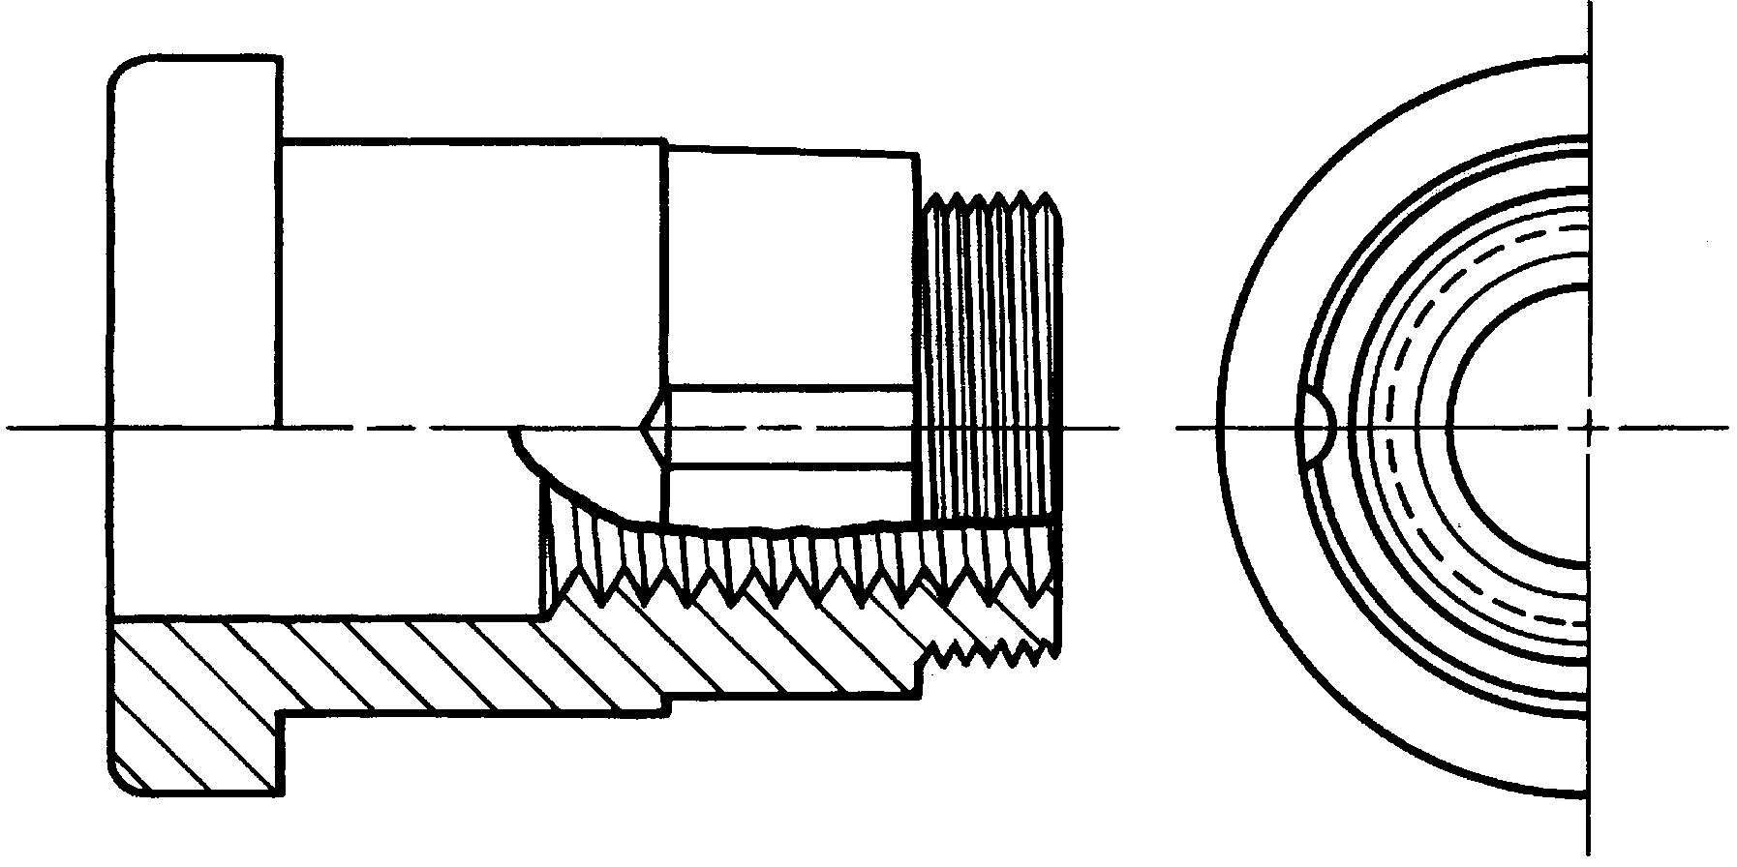
Half-section with break around a keyway

Slide 14
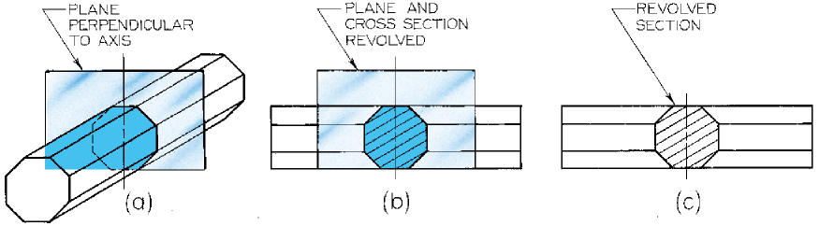
Revolved Sections
Revolved sections are used to show the cross-sectional shape of a bar, spoke, or arm in a single view. The cross-section is taken perpendicular to the view and then revolved 90 degrees around the center axis.

Slide 15
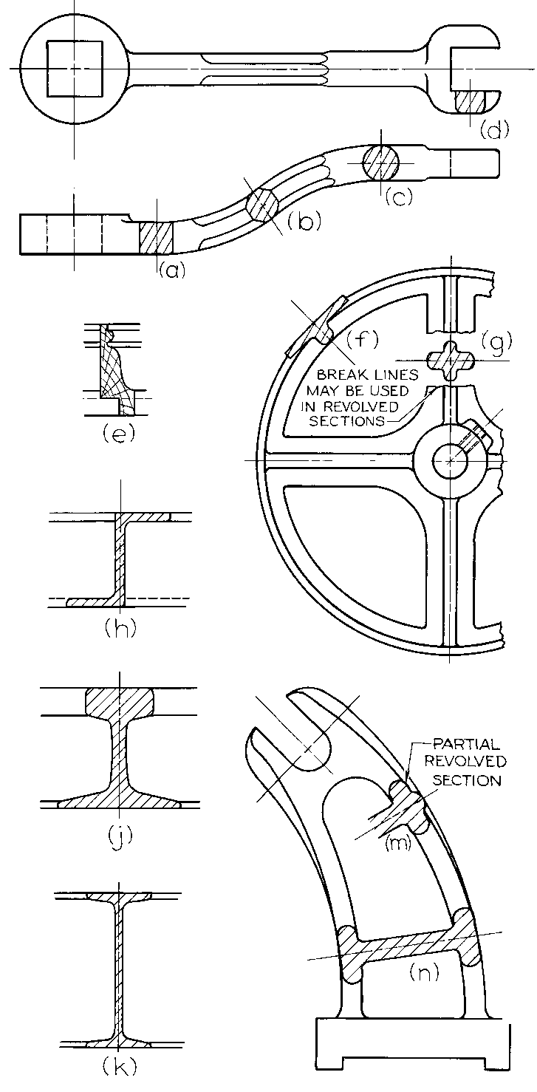
Examples of
Revolved Sections

Slide 16
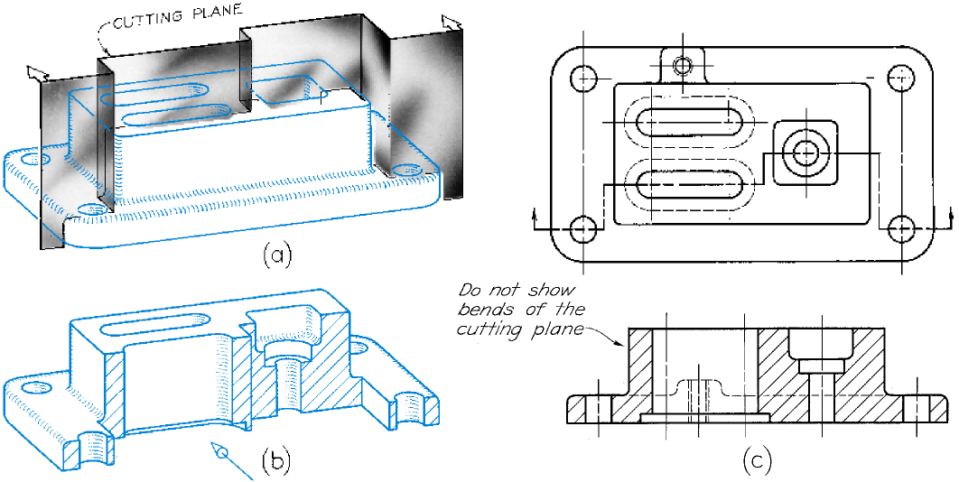
Offset Sections

Slide 17
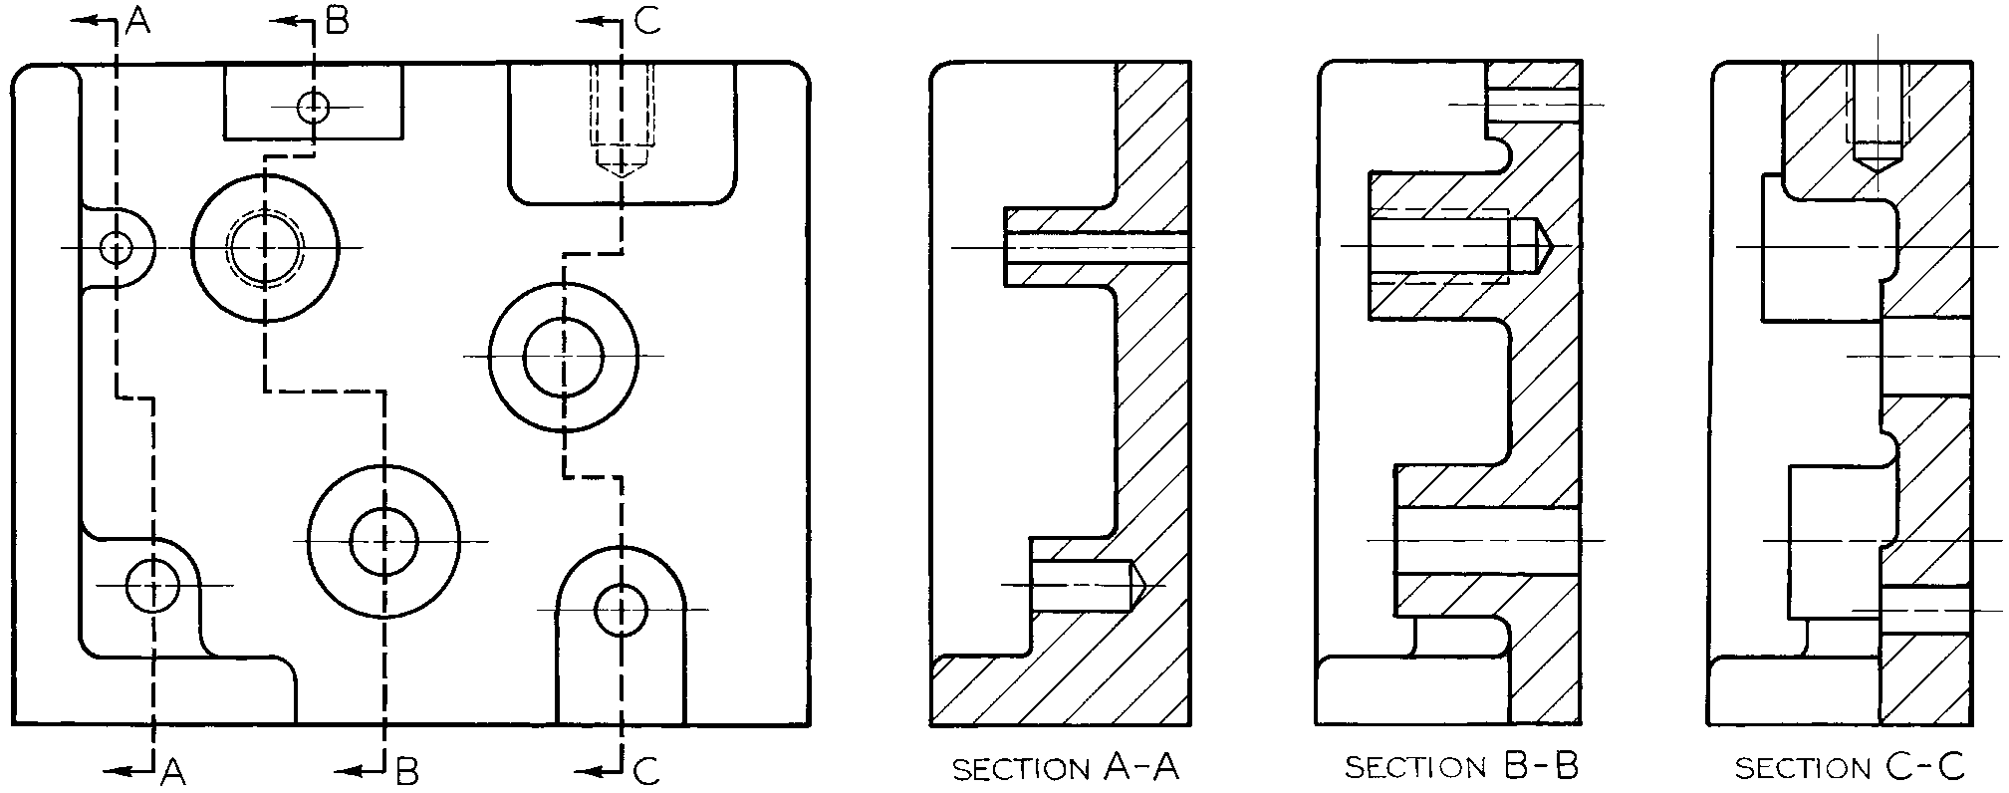
Three Offset Sections
Notice the ends of the cutting plane labeled with letters and the sections views neatly arranged and labeled to match.

Slide 18
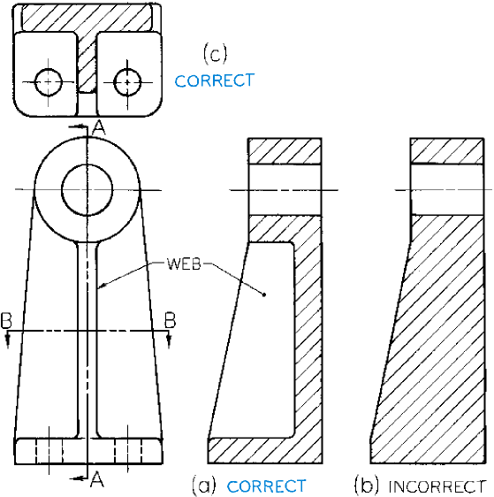
Do not hatch ribs & webs
When ribs, webs, and other thin flat parts are hatched, it gives a false impression of the object’s solidity. Leave the hatching of such features even though the cutting plane passes through them.

Slide 19
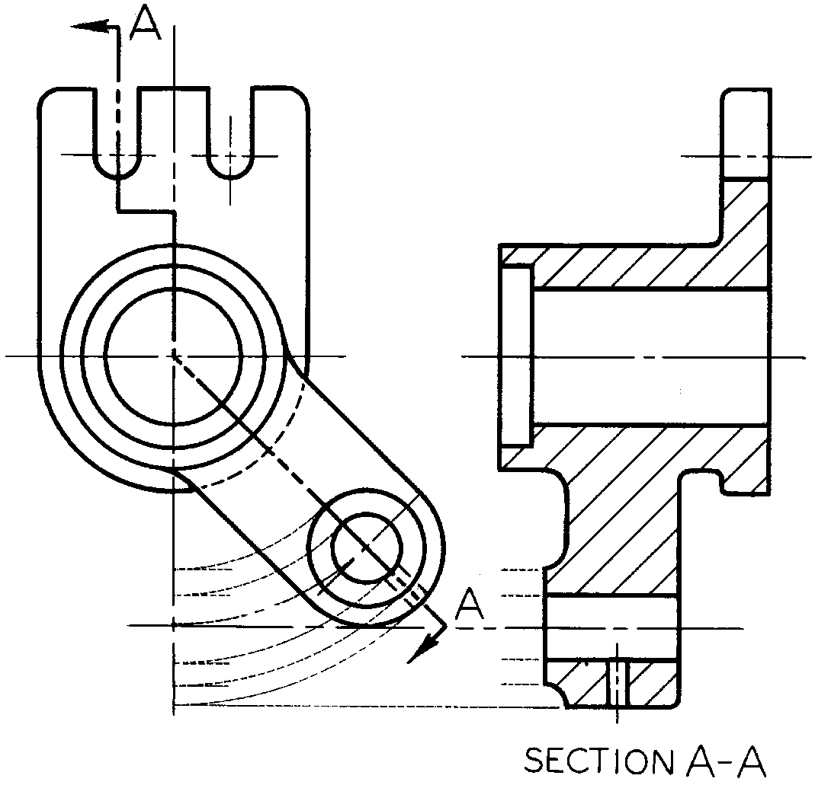
Aligned Sections
Aligned sections use an angled cutting plane to pass through angled features. The plane and feature are then imagined to be revolved into the original plane and the section projected from there

Slide 20
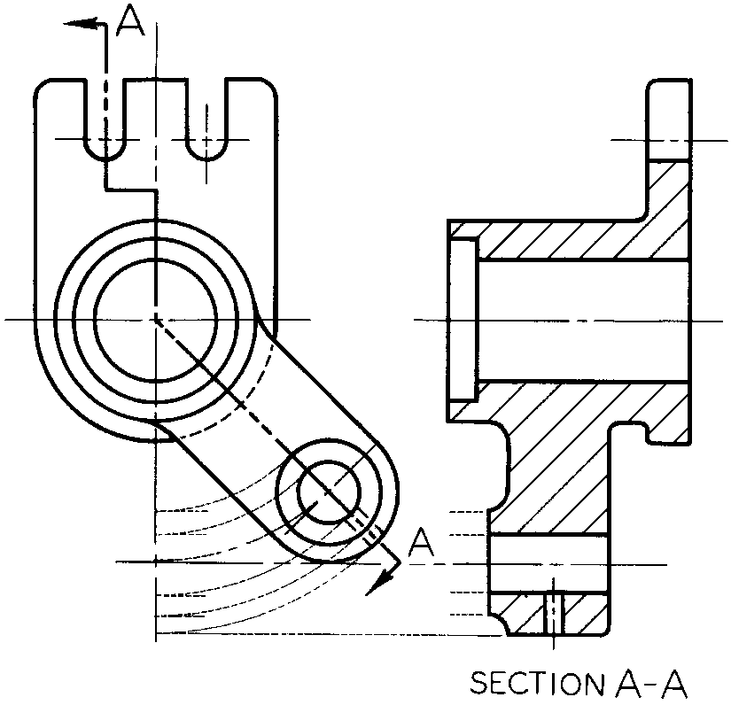
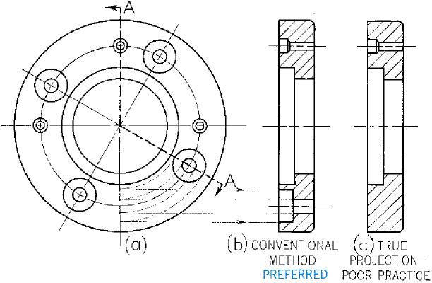
Examples of Aligned Sections

Slide 21
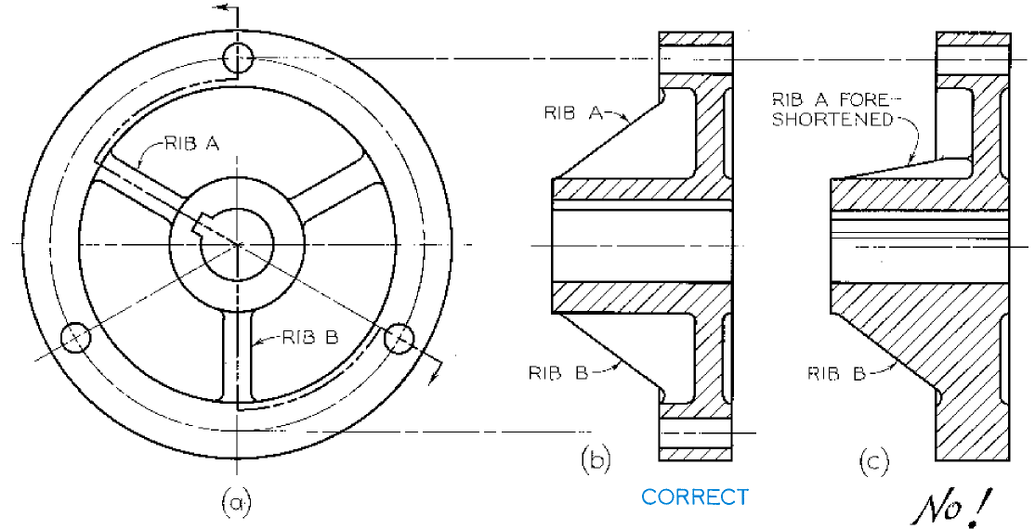
Revolve Symmetrical Features

Slide 22
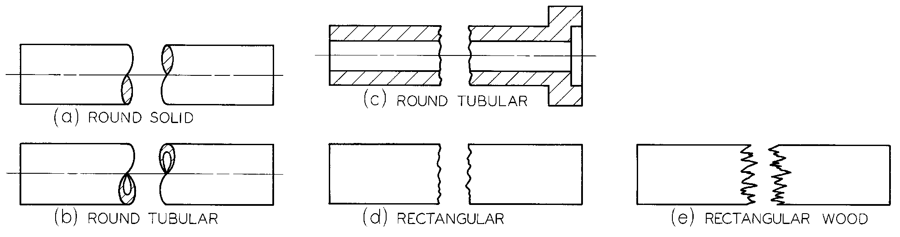
Conventional Breaks

Slide 23
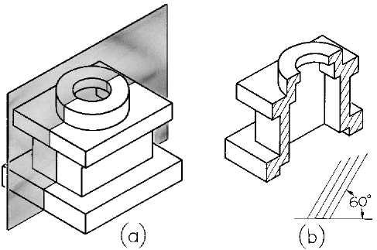
Isometric Half-Sections

